Slide 1
Wandering in Woods(Simulation Game)

Slide 2
Introduction
The major purpose of application is to develop the core level understanding to utilize the process of implementation .
The game is basically Wandering into the woods, and the game is based on the health and energy such as the user start the game , then the wander through the forest , in case if the user is stuck into the trees , the energy level will be down , and game will end by showing the ending message .
It is necessary to show the complete functional implementation based on which the utilization strategies could be done

Slide 3
Process Model
In agile, a product is produced in a number of fixed-length rounds called sprints, offering agile teams a structure for producing code on a regular basis to make sure. Learn how the scrum technique effects traditional project management.
Kanban is a prominent agile methodology that requires real-time information of group's capacity and complete disclosure of work. Learn how the Kanban method of agile software development might benefit for your team.
Agile project management is an incremental strategy to managing software projects that focuses on frequent releases and client feedback. Start here now for your agile transition.
Instructions for joining an agile team as a brand manager or product owner. Discover the ins and outs of creating product roadmaps, setting feature priorities, writing product requirements papers, and making informed decisions with product analytics.

Slide 4
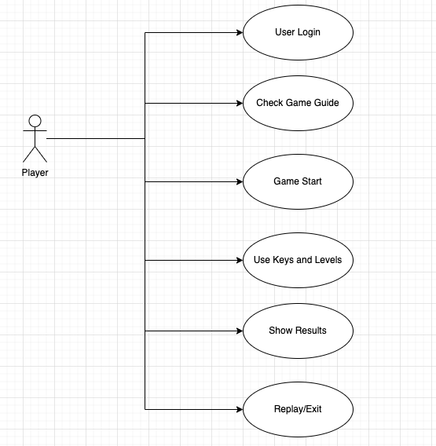
Use case diagram

Slide 5
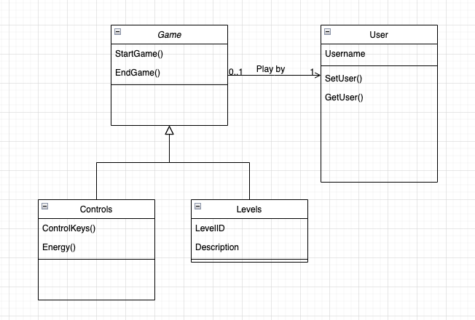
Class Diagram

Slide 6
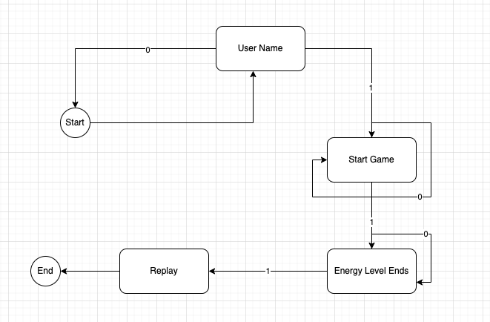
State Diagram

Slide 7
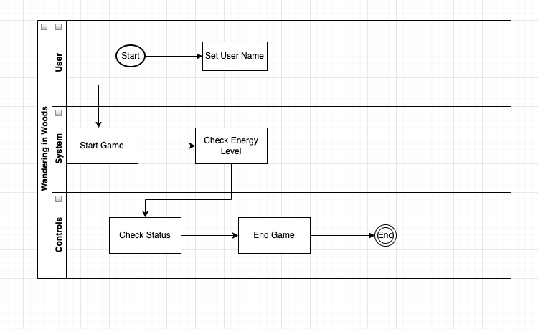
Activity Diagram

Slide 8
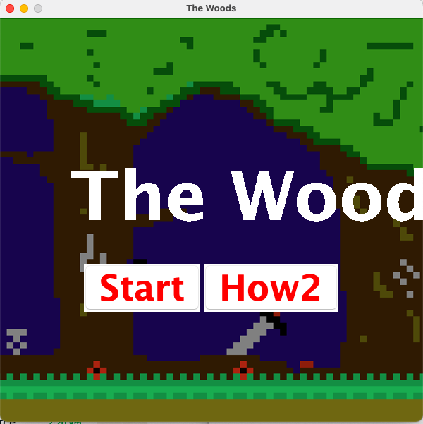
Application Front End

Slide 9
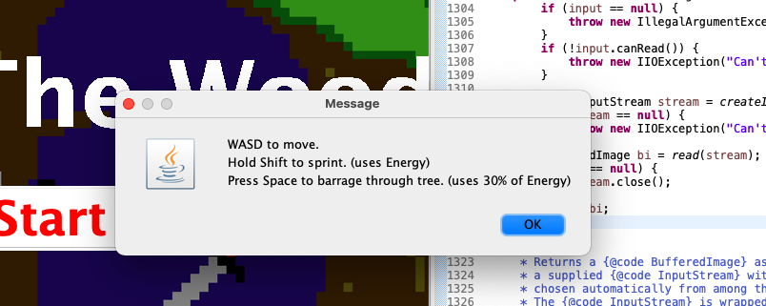
Guide

Slide 10
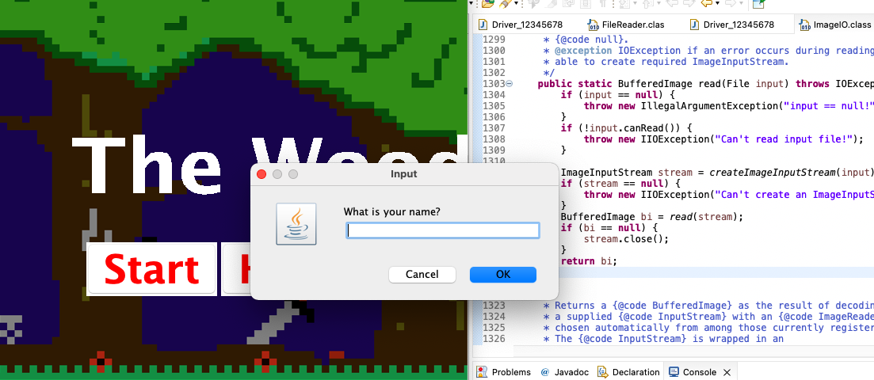
Taking Username

Slide 11
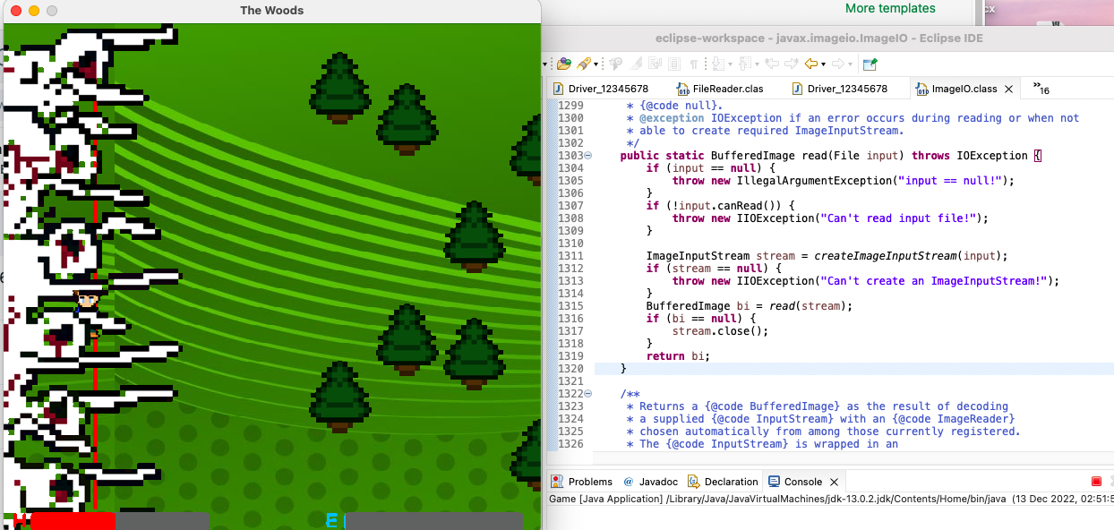
Running Game

Slide 12

End Game

Slide 13
Testing Strategies
For the current implementation of simulation game , Unit testing and integrated testing has been used to ensure the quality of service.

Slide 14
Unit testing
The methods will be evaluated as they are generated to validate the framework as it is developed.
In object-oriented programming, the class is considered as the smallest unit, although the smallest testable portion remains the method of the classes.
Hence, independent of your practices remain the target of unit tests.
However, the tactics in testing must alter with OOP as it may be impossible to test a single action in solitude resulting in the necessity to test sequences or methods included in a class.

Slide 15
Integrated Testing
When evaluating an application's API, integration testing is performed to guarantee that not only do all API calls succeed, but also that the methods themselves function as intended.
Often, test suites of system testing are done at a routine period as part of an automated testing process, which is how integration testing is performed.
Because of the many tests and dependencies between the various pieces of software, it is often impossible for a single engineer to run an entire integration test suite manually

Slide 16
Conclusion
It is concluded that complete details about simulation game development have been explained to measure the complete requirements of the system to develop the context of analysis with respect to manage the complete development of the application.
A complete object oriented approach has been used to measure the integrated analysis with respect to the service level implementation of functional system requirements.
All classes and UML modeling are well mapped to show the complete systematic requirements of project.

